Slide 1
INFO 656-01 Fall 2020 ML Ecosystem
Week 11
Amir Imani

Slide 2
Cloud Computing is the New Norm
On-demand availability of computer system resources – like data storage and computing power - without direct active management by the user.
Usually pay as you use
Multiple vendors: Amazon (AWS), Google (GCP), Microsoft (Azure), etc
Public, Private, Hybrid models

Slide 3
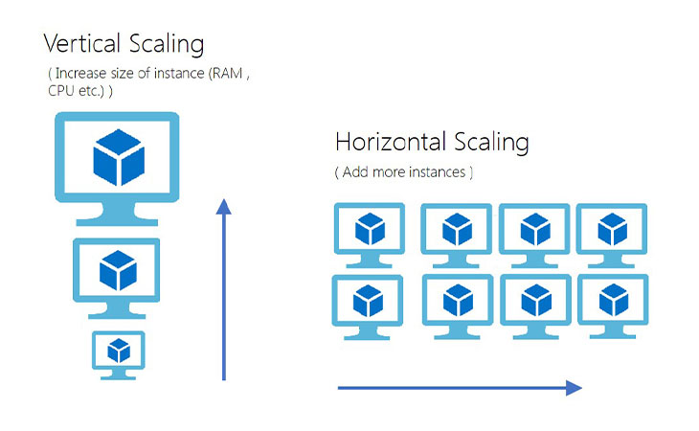
Benefits of Cloud Computing
Cost: No upfront cost
Speed: horizontally and vertically scalable with a few clicks
Reliability: backups and disaster recovery
Security: policies, technologies, and controls
to strengthen overall security
https://www.webairy.com/horizontal-and-vertical-scaling/
Notes:
Cost
Cloud computing eliminates the capital expense of buying hardware and software and setting up and running on-site datacenters—the racks of servers, the round-the-clock electricity for power and cooling, and the IT experts for managing the infrastructure. It adds up fast.
Speed
Most cloud computing services are provided self service and on demand, so even vast amounts of computing resources can be provisioned in minutes, typically with just a few mouse clicks, giving businesses a lot of flexibility and taking the pressure off capacity planning.
Reliability
Cloud computing makes data backup, disaster recovery, and business continuity easier and less expensive because data can be mirrored at multiple redundant sites on the cloud provider’s network.
Security
Many cloud providers offer a broad set of policies, technologies, and controls that strengthen your security posture overall, helping protect your data, apps, and infrastructure from potential threats.

Slide 4
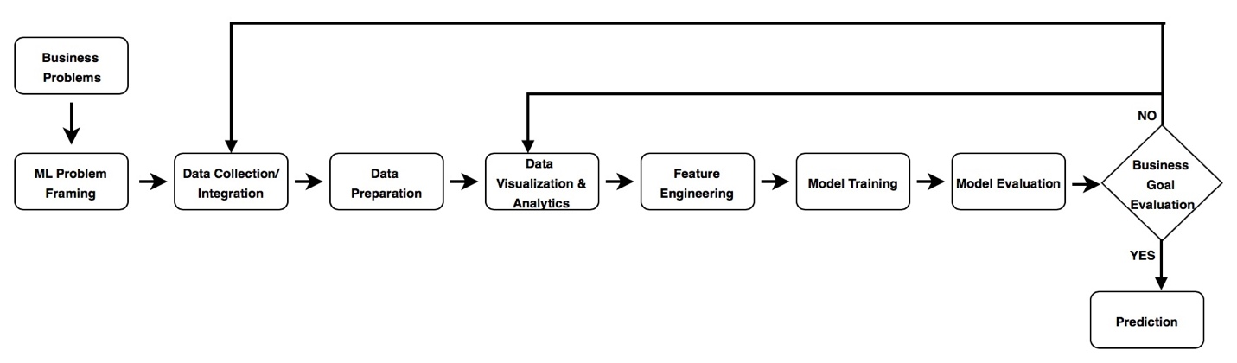
Useful resources
AWS Well-Architected Framework - Machine Learning Lens (link)
Google Colab
Model Zoos
Notes:
Building and operating a typical ML workload is an iterative process, and consists of multiple phases. We identify these phases loosely based on the open standard process model for Cross Industry Standard Process Data Mining (CRISP-DM) as a general guideline. CRISP-DM is used as a baseline because it’s a proven tool in the industry and is application neutral, which makes it an easy-to-apply methodology that is applicable to a wide variety of ML pipelines and workloads.
design principles: Operational Excellence Pillar
Security Pillar
Reliability Pillar
Performance Efficiency Pillar
Cost Optimization Pillar
Colab: Zero configuration required
Free access to GPUs
Easy sharing

Slide 5
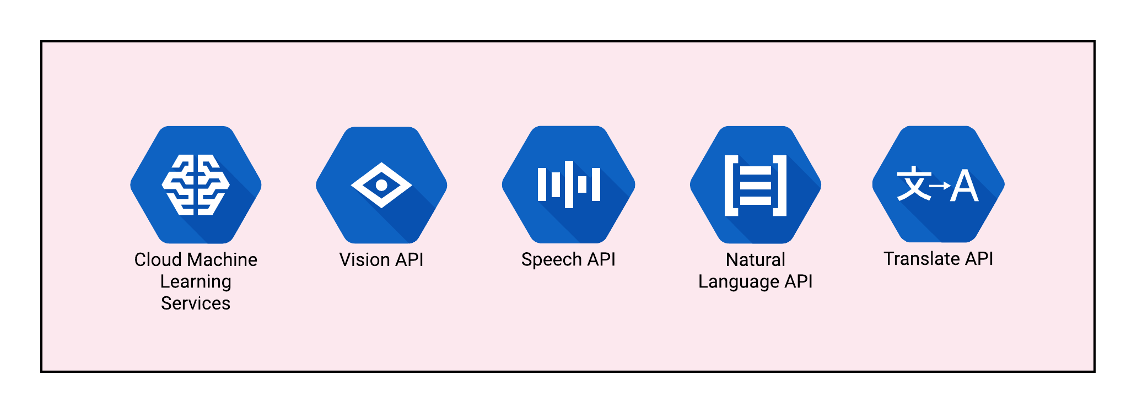
AI services
Pre-trained AI Services for computer vision, text, speech, and so on
Accessible through APIs

Slide 6
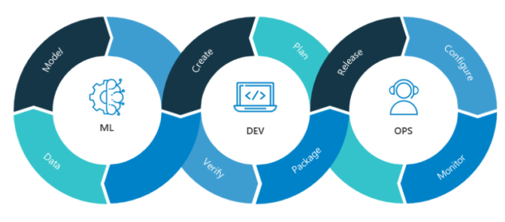
MLOps
A practice for collaboration and communication between data scientists and operations professionals to help manage production ML lifecycle.
https://blogs.nvidia.com/blog/2020/09/03/what-is-mlops/
Notes:
A shorthand for machine learning operations, MLOps is a set of best practices for businesses to run AI successfully.
MLOps is modeled on the existing discipline of DevOps, the modern practice of efficiently writing, deploying and running enterprise applications. DevOps got its start a decade ago as a way warring tribes of software developers (the Devs) and IT operations teams (the Ops) could collaborate.
MLOps adds to the team the data scientists, who curate datasets and build AI models that analyze them. It also includes ML engineers, who run those datasets through the models in disciplined, automated ways.
It’s a big challenge in raw performance as well as management rigor. Datasets are massive and growing, and they can change in real time. AI models require careful tracking through cycles of experiments, tuning and retraining.
To summarize: track, compare, explain and optimize experiments and models.

Slide 7
Questions?

